Slide 1
Fog
1 year exam
By Felesiah Yolanda Krøier

Slide 2
Program specifications
Register/Login
Choose desired dimensions
Create a sketch
Print a Parts list

Slide 3
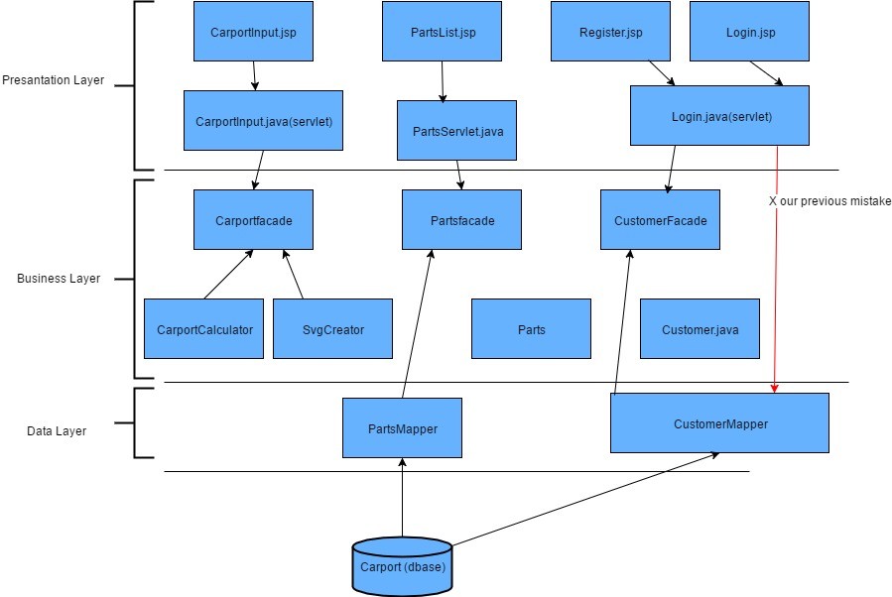
Three Layer Architecture
By dividing an application into layers, developers attain the option of modifying or adding a specific layer, instead of reworking the entire application.
Presentation Layer:- consists of jsps, and servlet for managing user
interaction with the system. .
Business Layer:- :-consists of customer.java, also facades are in
this layer, helper classes such as carport
calculator etc. Core functionality of the program.
Data Layer:- consist of connector class, datamappers basicly here is
where the connection to the database is established and
retrival of data from database by use of querries

Slide 4
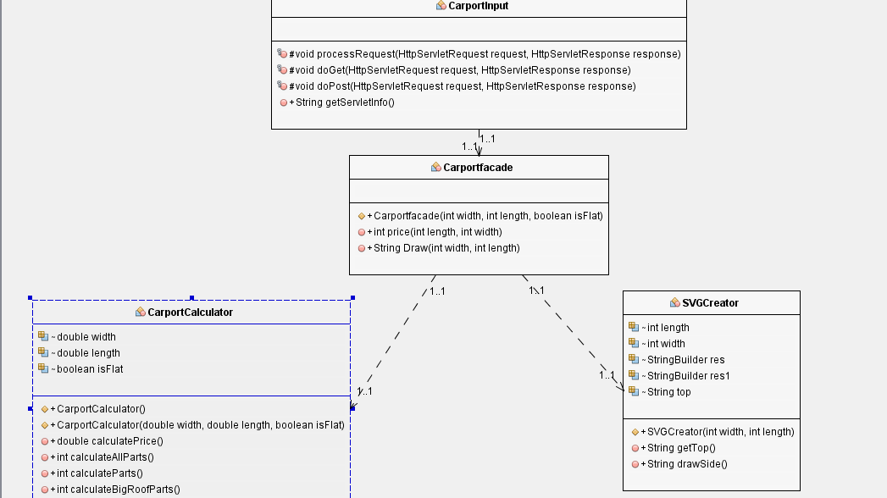
The moment a user choose their desired width and height.

Slide 5

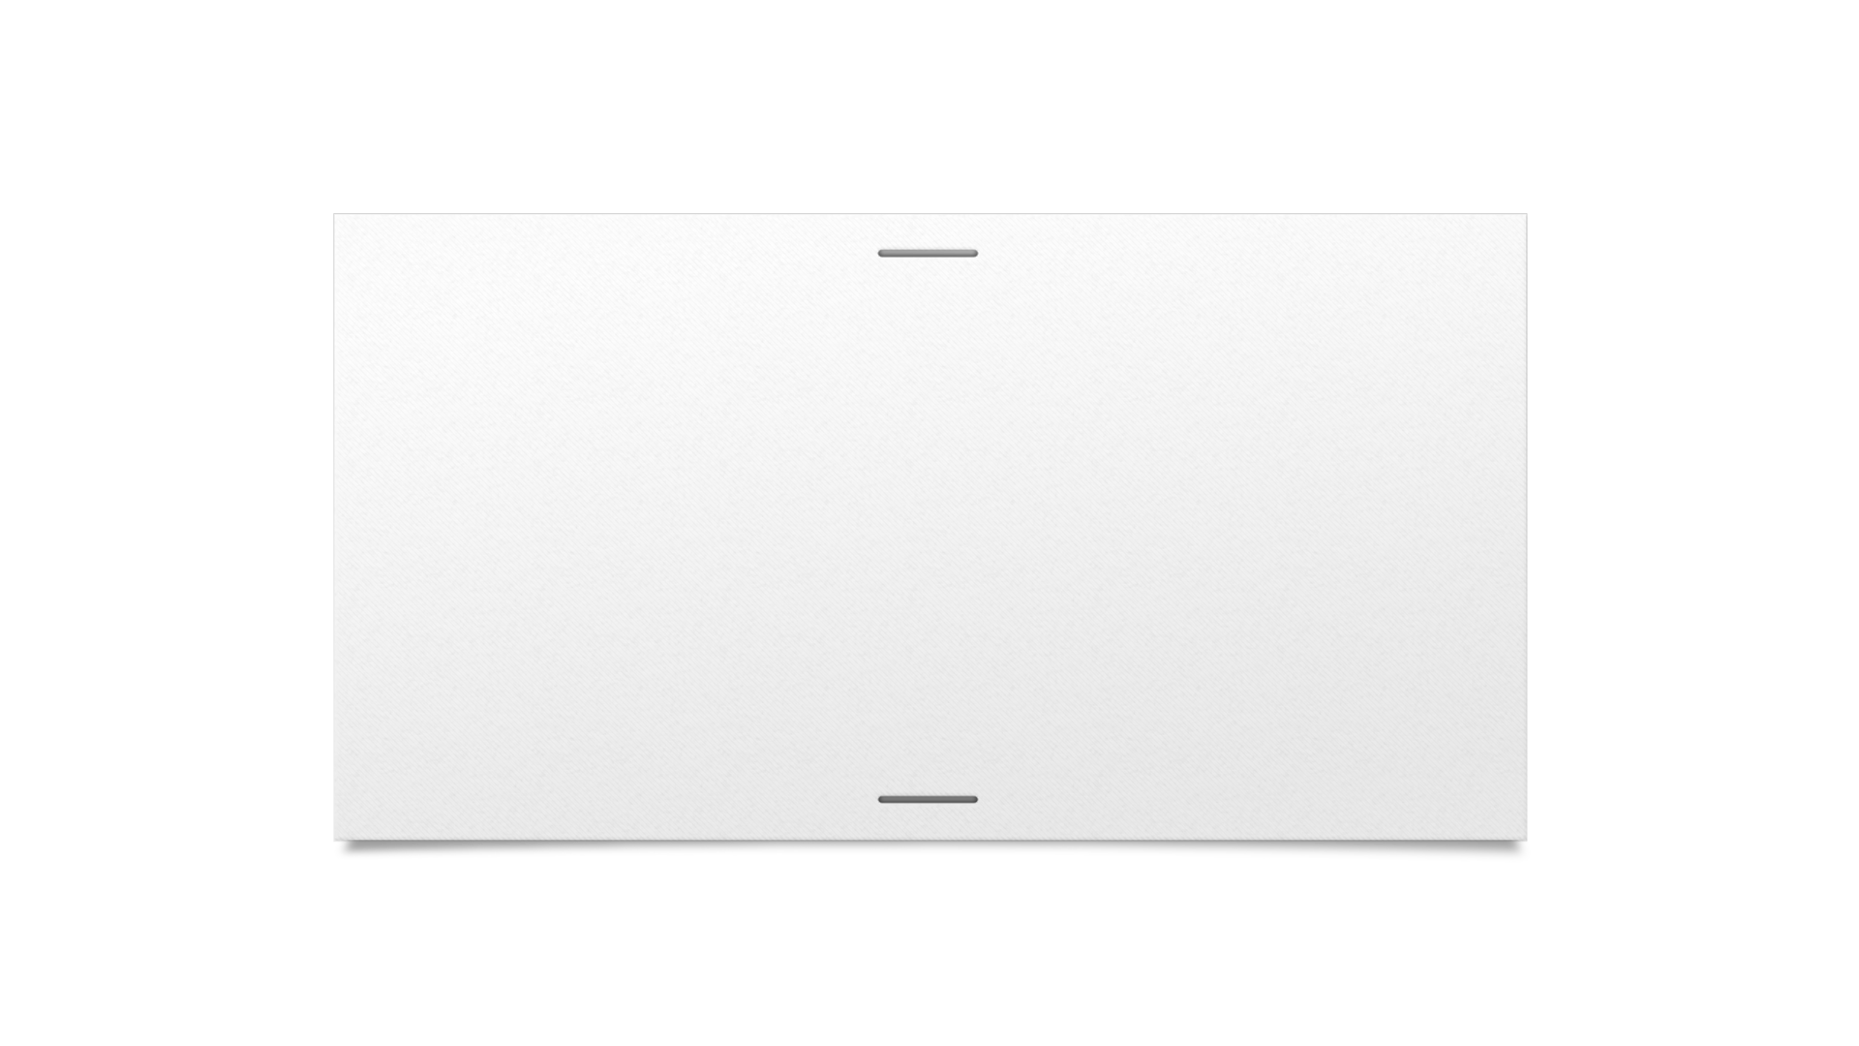



Connection to database when a customer logs in.
Index.jsp
Login.jsp
Login.java
Customer.java
CustomerMapper.java
JDBC
Dbase

Slide 6
Scrum
Product owner
Scrum master
Development team
Daily scrum meeting
Sprint reviews
Retrospective meetings

Slide 7











Traceability model
Vision | Goals | Features
⇀ User friendly ⇀ Increase sales -- Presentable sketches --Improves Fog efficiency of custom ordering process. | ⇀ Increase use by 60 % within 12 months. ⇀ Increase carport sales by 50% Within 12 months. -- Retain our customers by 90% satisfaction regarding the process of ordering a custom carport. --reduce working hours by 40% per sale. | ⇀ User friendly website ⇀ Random generating, carport sketch. --sales person overview of orders. --Creating an overviews of orders.

Slide 8
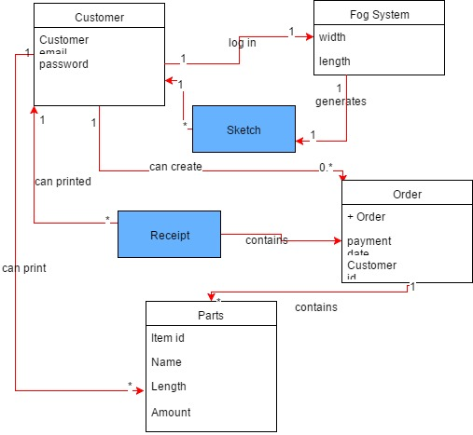
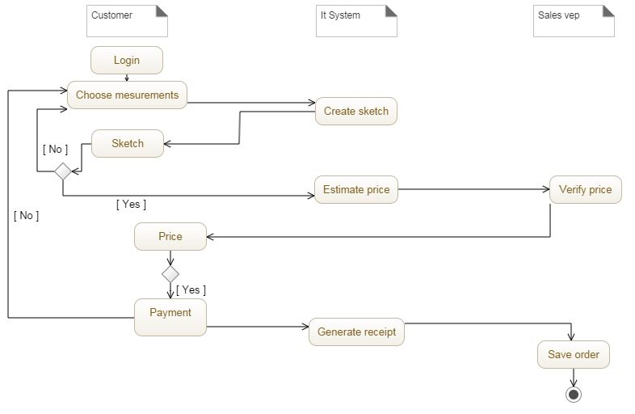
Domain diagram
Activity diagram

Slide 9
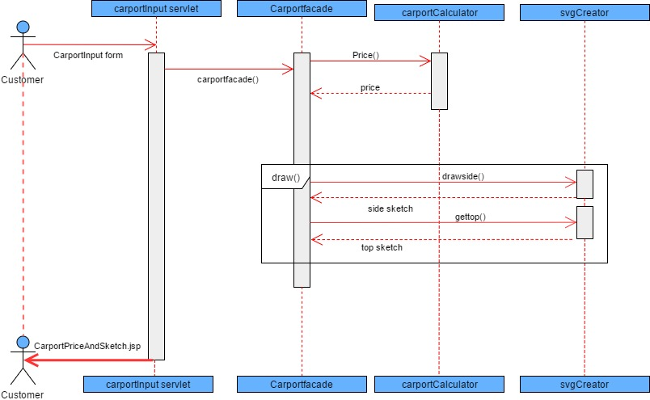
Sequence diagram explaining the generating of carport sketch and price.
Sequence diagram

Slide 10
Product backlog
ID | Name | Role | Estimated time. | How to demo | Sprints
1 | Login | customer | 12h | Input username, password, go to the database name has been added . | Week 12
2 | Selection of carport | customer | 24h | Log in, choose carport, input own measurements. | Week 12 + Finish in week 13
3 | Generating Sketch of carport | customer | 30h | Log in , input measurements, Generate sketch | Week 13 - week 16
4 | Price calculation | customer | 16h | Log in, choose carport, input measurements, calculate the price. | Week 17

Slide 11
USER STORIES:
1. As a customer I would like to be able to register with my credentials so that I can be able to purchase a carport.
2. As a customer I would like to be able to login so that I can be able to purchase a carport.
3. As a customer I should be able to input measurement for the carport I want.
4 As a customer I should be able to browse through different carport to see which style I want.
5. As a customer I should be able to generate a sketch of a desired carport so that I can see which style suits my desires.
6. As a customer I should be able to calculate the price for the parts to be purchased so that I can purchase a pocket friendly carport.
7. As a customer I should be able to make payment of my orders so that I can get my carport parts delivered on time.
8. As a customer, I would like to see details of the contact person from my order so that I can know whom to contact in case something went wrong with the items I have ordered.
9. As a customer I should be able to place orders so that I can get a list of all parts .
10. As a customer I should be able to check the state of my order so that I can know when I will get my ordered items.
11. As a customer I should be able to print the receipt so that I can have prove of purchase in case I return items.
12. As a worker I would like to see orders, placed by customers so that we can keep track of our customer.
13. As a worker I would like to be able to check my schedule for the week/month so.
14 . As a worker I should be able to access customer’s information so as to contact contact them if the need to contact them arise.
15. As a customer I should be able to browse different products by type so that I can choose the product that suits my need.

